Slide 2
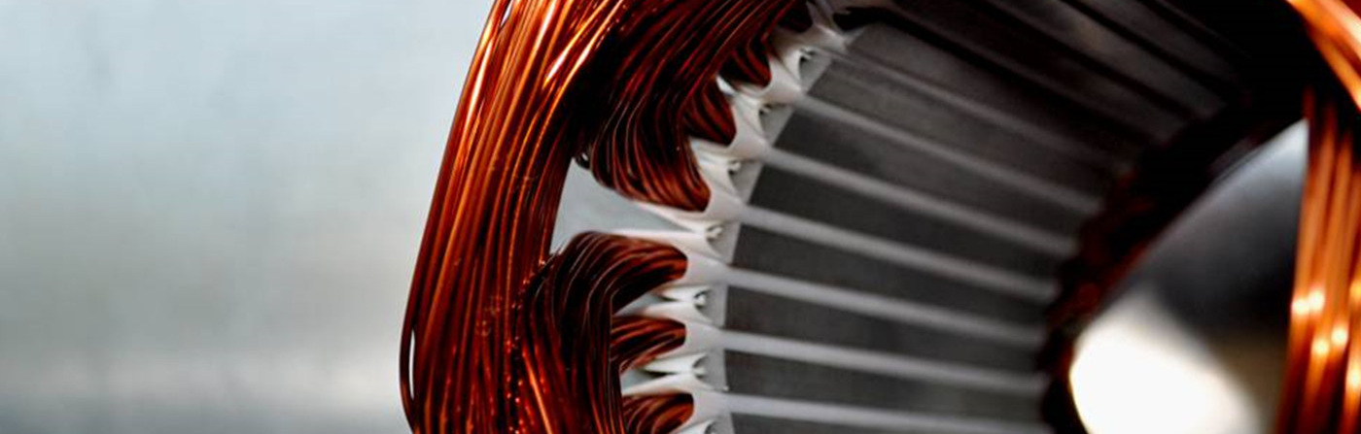
Development of A Parametric Tool for Automated Slot Insulation Insertion in Small-Scale Electric- Motor Stator Production
Alen Sebastian 23221507 (M Sc Electromobility)
Project Thesis Presentation

Slide 3
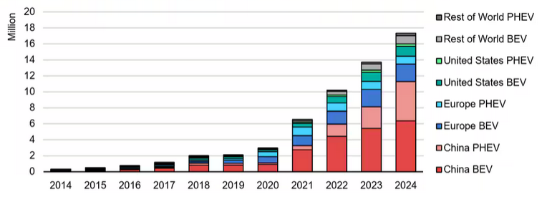
Climate change and CO₂ emissions drive the need for sustainable mobility, leading to a rapid rise in electric vehicle demand.
Climate change & CO₂ emissions → need for sustainable technologies
Transport sector accounts for about 23% of global CO2 emissions
Electrification trend → rapid growth of EVs →surge in electric motor demand
Large-scale production: highly automated
Small-scale/custom production: still manual, especially slot liner insertion
Manual process = time-consuming, inconsistent, costly
Global EV sales [1]

Slide 4
Objective: To Develop a flexible insertion tool to automate slot-liner insertion in small-scale stator manufacturing
Flexible manufacturing
Automated Slot-Liner Insertion
Parametric Tool Design
Process reliability and repeatability
Robotic Integration and validation

Slide 5
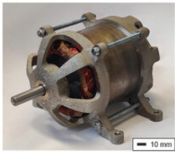
Producing a stator requires a sequence of precise manufacturing steps, ensuring structural integrity, insulation, and electrical reliability.
Key steps in stator manufacture involve:
Core Preparation – Laminated electrical steel sheets are cut, stacked, and bonded to form the stator core.
Insulation Insertion – Slot liners and other insulation elements are placed to isolate windings from the core.
Winding & Interconnection – Copper wires are wound into slots and interconnected (crimping, soldering, welding).
Stabilization & Testing – Resin impregnation improves insulation and thermal performance, followed by electrical tests for quality assurance.
Fully assembled motor [2]

Slide 6
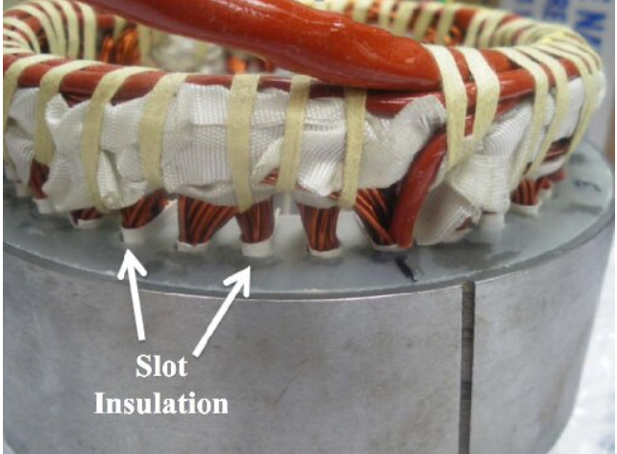
In stator production, slot liners are essential components that ensure proper insulation of the windings and protect against mechanical wear during operation.
Electrical Insulation
Thermal Management
Wear Resistance
Winding Retention
Slot Insulation in a stator [3]

Slide 7
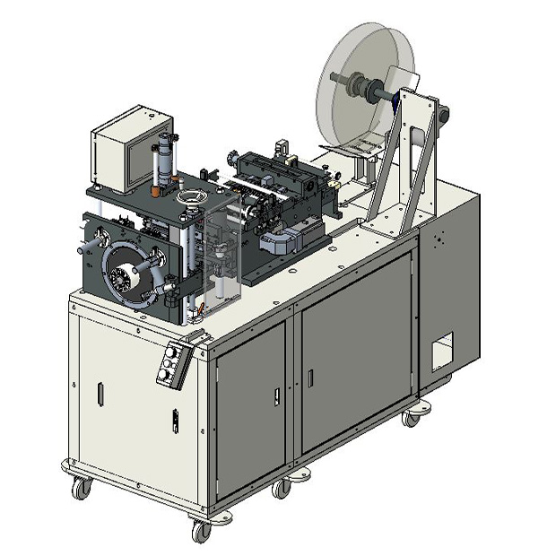
How slot liners are inserted in large scale manufacture such as in the automotive industry:
Large batch manufacture with constant motor size.
High Investment costs.
High speed insertion (3 sleeves per second).
. GMW CS-5E Horizontal Slot Cell Inserter [4]
Not suitable for high variance, low volume production.
Integrated cutting, folding and creasing.

Slide 8
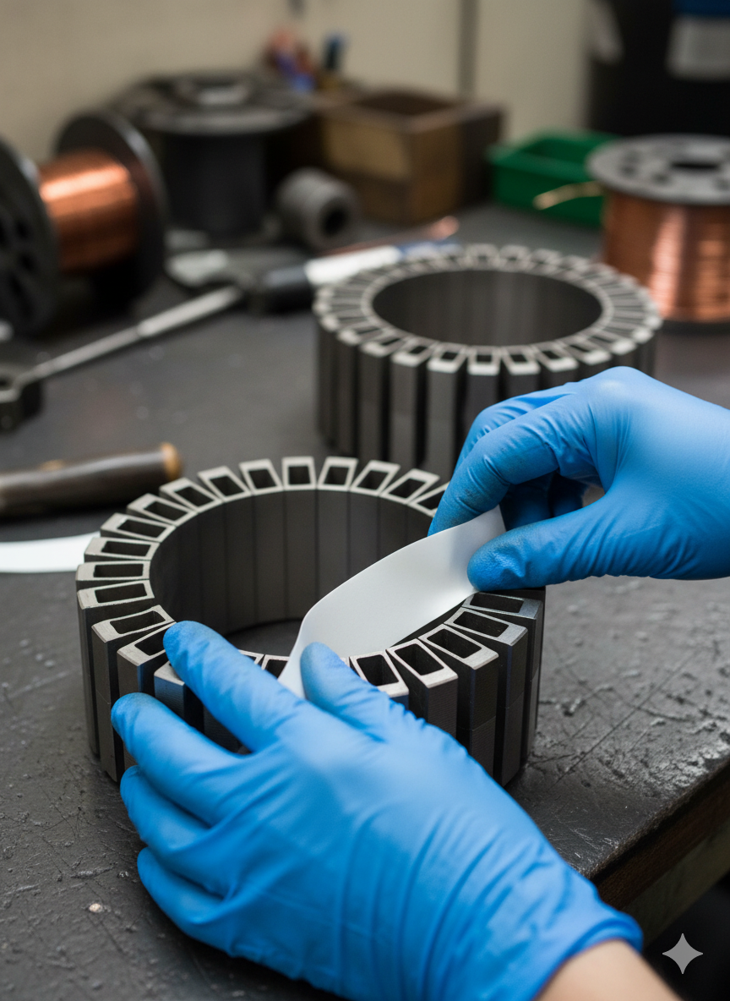
How slot liners are inserted in small scale manufacture such as in aviation or naval industries:
High variance low volume production.
Flexible, low cost.
Insertion is done manually.
Manual insertion of slot liner
Labor intensive, difficult to scale.
Use of jigs, cutting/folding machines.
*AI generated image

Slide 9
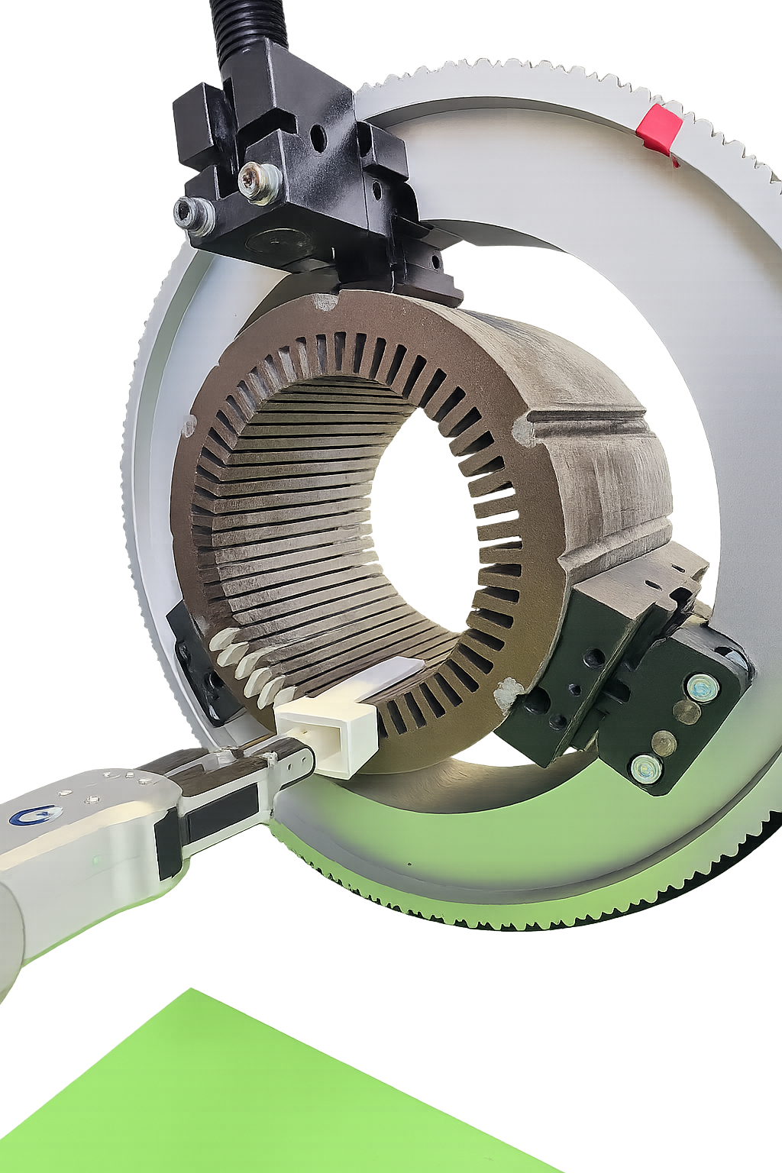
Introducing a Parametric Funnel for Automation of Slot Liner Insertion.
Approach:
Parametric funnel adaptable to different stator configurations
Three key parameters can be adjusted for varying stator types
Integration of the funnel with a collaborative robot for complete automation
Expected benefits:
Increased precision and reliability
Reduced labour intensity
Flexibility for small-batch, high-variance manufacturing
Parametric Funnel

Slide 10
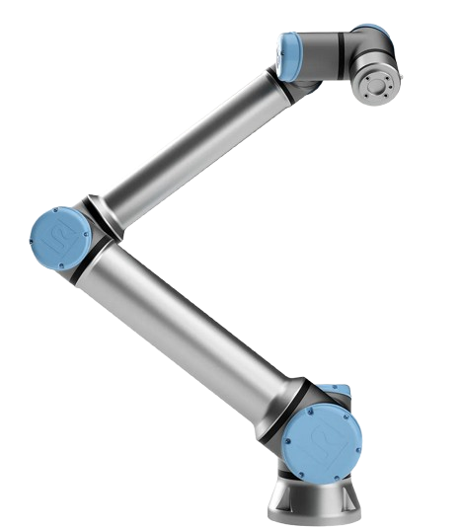
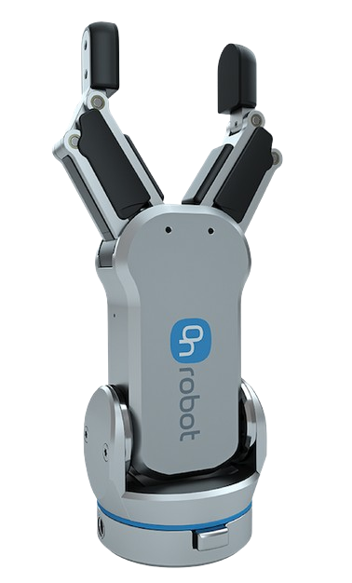
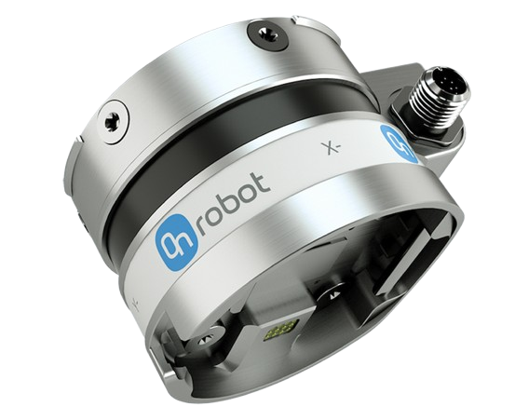
Robotic Module for Automated Insertion: UR10e Collaborative Robot, RG2 Gripper, and Force/Torque Sensor
UR10e Cobot:
Precise programmable motion 12.5 kg payload 1300 mm reach Compact and safe Easily adaptable for flexible manufacturing
RG2 Gripper:
Adjustable 2 finger gripper 110 mm stroke length Intelligent grip detection Customizable fingertips Suitable for secure handling of Slot Liners
HEX Force-Torque Sensor:
Real-time force monitoring 6 axis Force Torque measurement Ensures accurate insertion of liner Misalignment detection Configurable force thresholds
Source: UR robots [5], On robot [6]

Slide 11
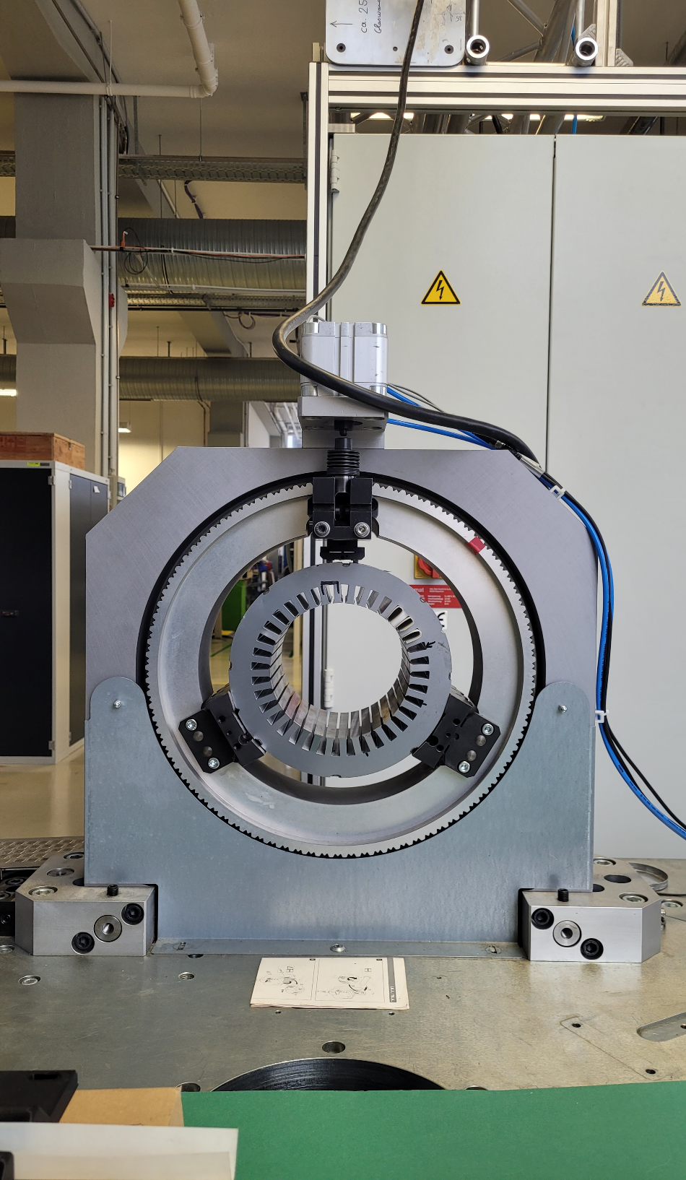
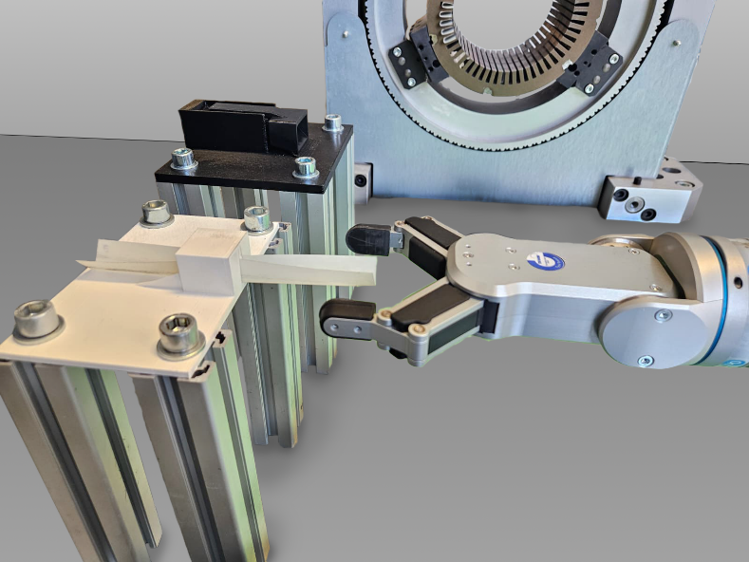
Mechanical Fixtures for Accurate Positioning of Stator, Slot Liner, and Funnel
Rotating Mechanical Clamp
1). Automatic Slot Alignment: User-defined rotation ensures perfect alignment of each slot for insertion. 2). Servo Motor + Siemens S7-1500 PLC - Provides precise, deterministic low-level motion control. 3). Manual origin calibration, stop-rotation function for safety, collision avoidance, and adaptability
Slot Liner and Funnel Positioning Platforms
1). Secure, repeatable positioning for insertion tool and slot liners 2). Quickly accommodates different funnel or slot liner geometries with minimal downtime. 3). Ensures accurate robot grasping, reducing misalignment and improving repeatability. 4). Enhances workflow efficiency in small-batch or high-mix production while maintaining precision.

Slide 12
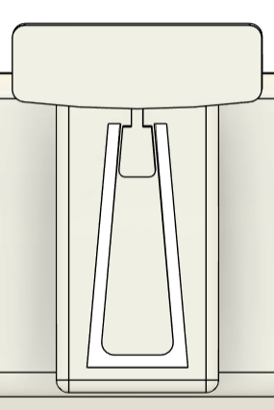
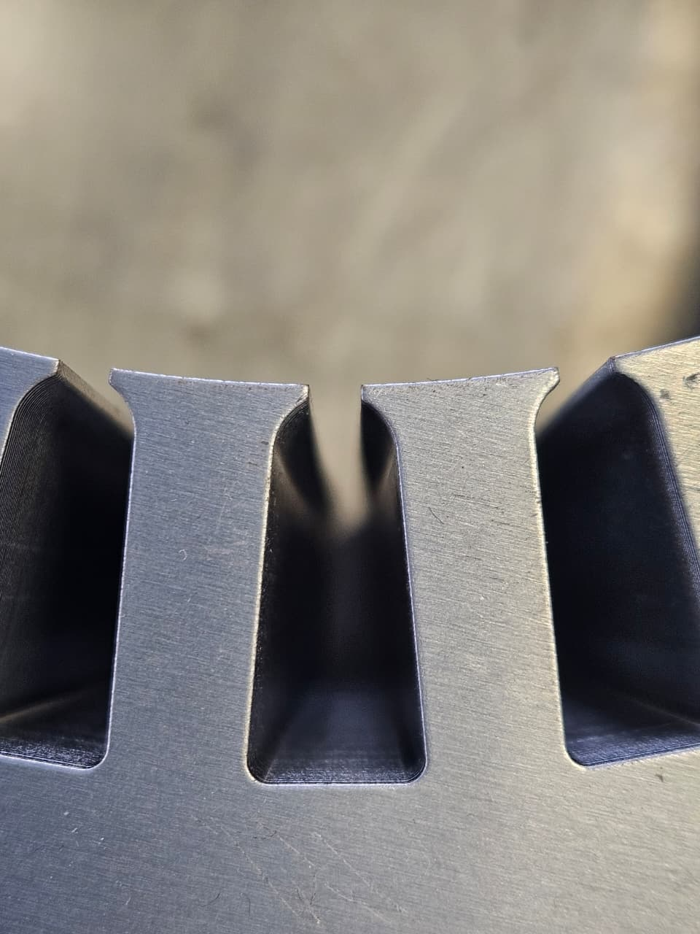
Key Parameters Considered for the Parametric Funnel Development:
Slot Height
Slot Angle
Slot Width
a) tool parameters
b) Actual slot in a stator

Slide 13
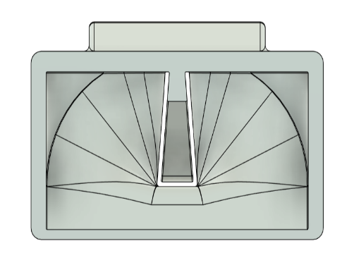
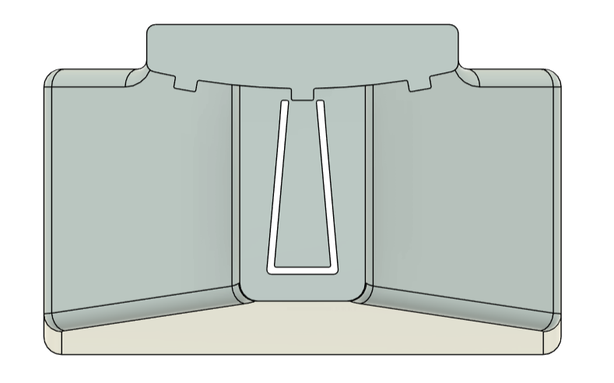
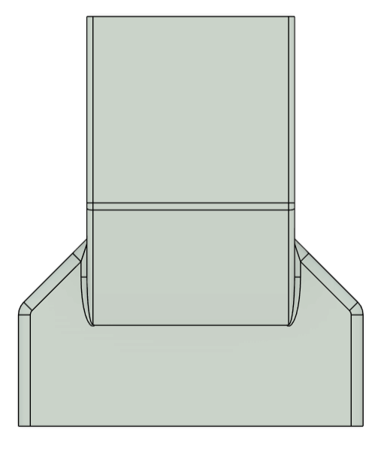
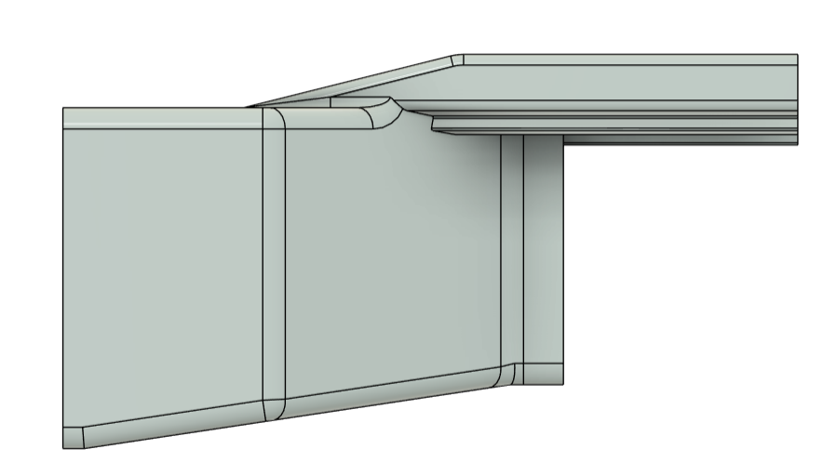
Initial Funnel Design: Parametric Geometry and Guiding Mechanism for Slot Liner Insertion.
Parametric funnel geometry, adaptable for different slot sizes.
Flared, tapered internal channel, that guides the slot liner smoothly towards the stator slot.
a) Front view
b) Rear view
Inner and outer guide rails to maintain precise alignment with the stator slot.
c) Side view
d) Top view
Cheap and Easily prototyped. Material used - PLA

Slide 14

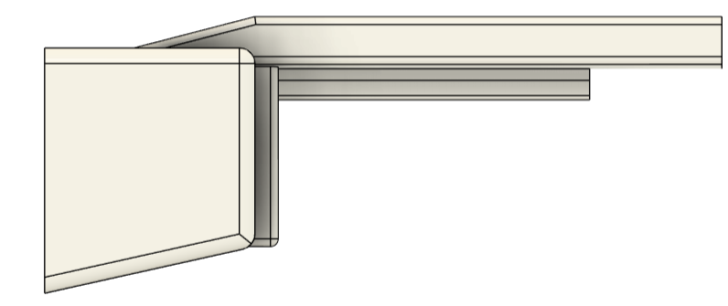
Observations and Limitations of the Initial prototype.
Prototype Evaluation:
The initial prototype confirmed the feasibility of the parametric funnel concept but revealed key weaknesses
Three external guide rails made insertion process-sensitive and dependent on precise alignment.
Short tail section and wide inlet shifted the center of gravity forward, causing funnel instability
Complex geometry reduced adaptability across stator types
Findings guided redesign for improved tolerance, locking, and stability in automated use.
Initial Prototype
Final Prototype

Slide 15
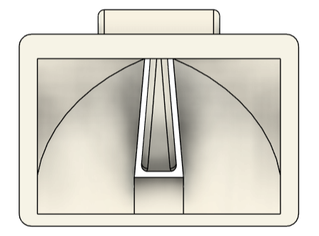
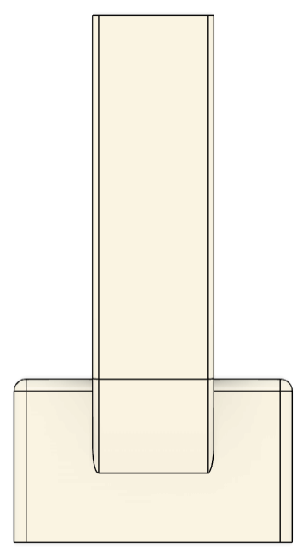
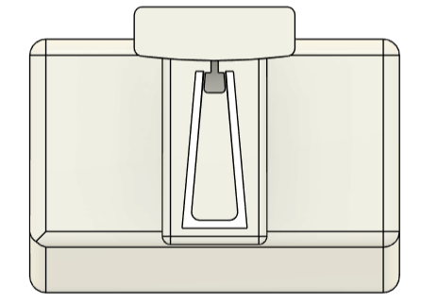
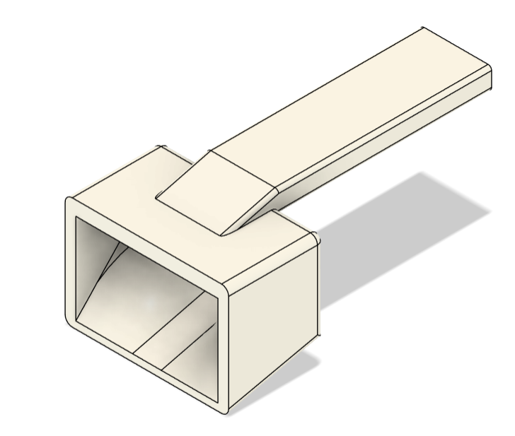
Final Design Development: Addressing the Shortcomings of the Initial Funnel Design
Simplified guiding system: Replaced three rails with a single elongated rail featuring grooves for mechanical locking and easier insertion.
Improved stability: Extended and thickened tail (by 50 mm) to shift the center of gravity rearward and prevent forward tilting.
a) Front view
b) Rear view
c) Top view
Refined outlet geometry: Slightly undersized outlet (2–3%) ensures smooth liner entry without edge damage.
Enhanced adaptability: Simplified overall geometry for easier parametric adjustments and faster design modifications.
d) Side view
e) Isometric view

Slide 16
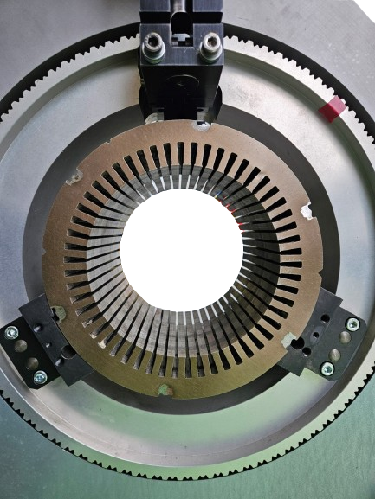
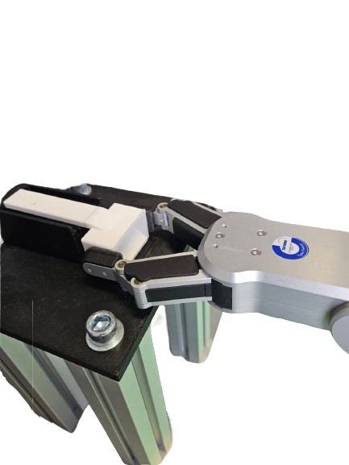
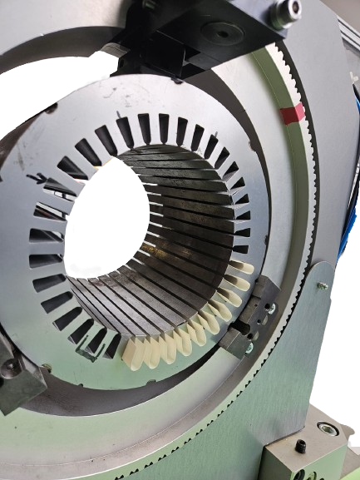
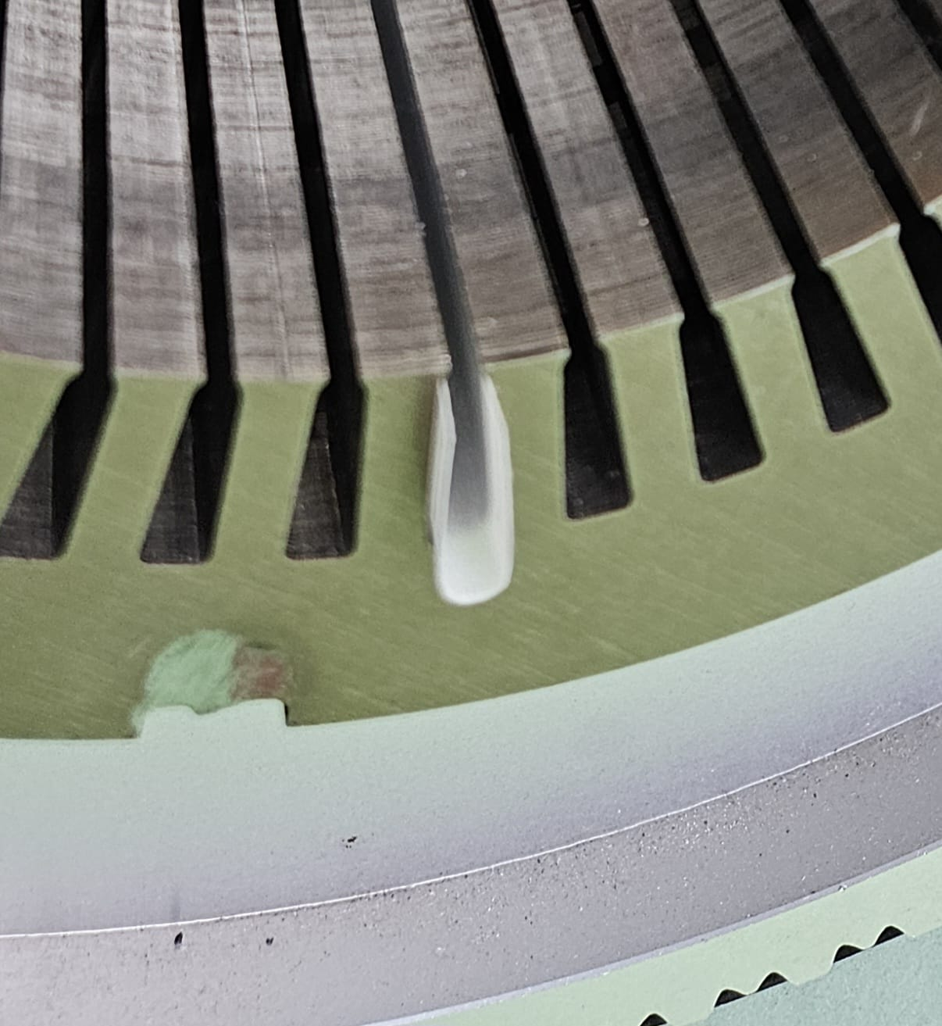
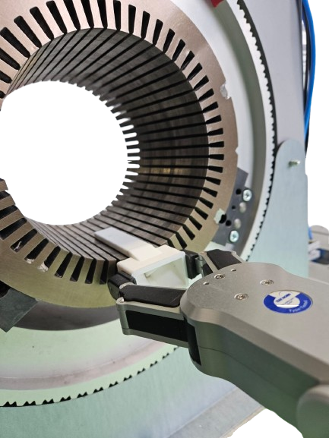
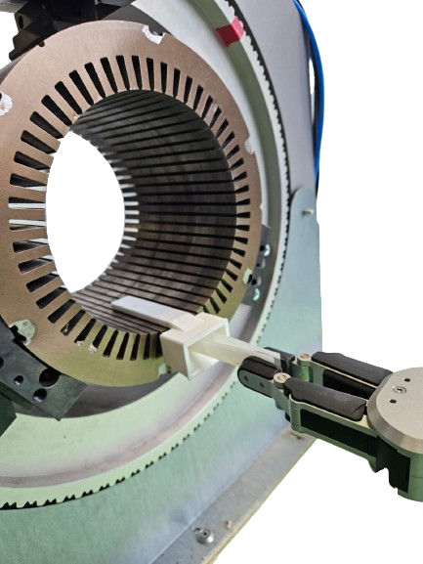
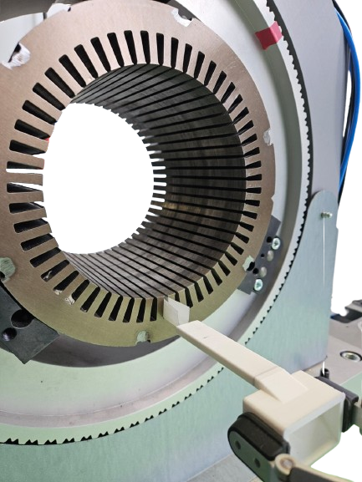
Automation Process of Slot Liner Insertion with the Proposed Parametric Funnel:
Picking Funnel from the platform
Insertion Completed
Stator without slot liner insulation
Partially insulated stator
Funnel Insertion
Slot Liner Insertion
Pushing the slot liner into the stator
Process iterated till n == number of slots

Slide 17
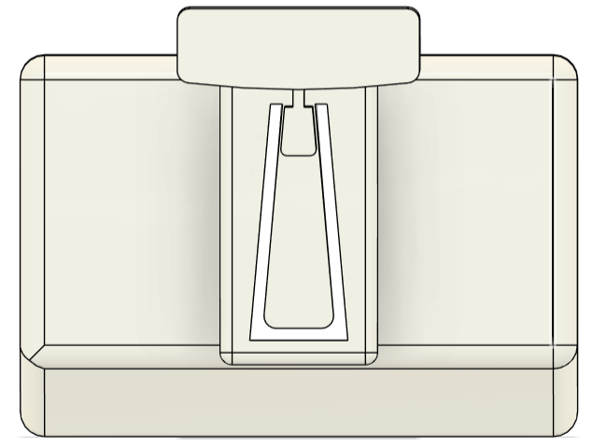
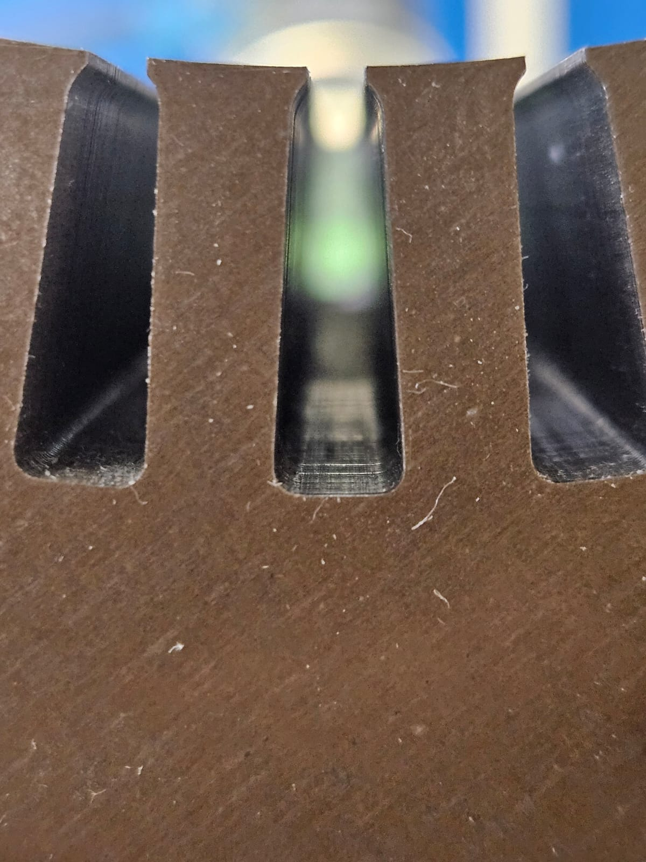
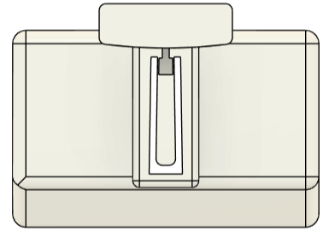
Funnel Validation: Evaluation Using Stators of Differing Geometries
Slot Height – 20 mm
Slot Width – 8 mm
Slot angle – 85 deg
Slot Height – 19.8 mm
Slot Width – 8 mm
Slot angle – 85 deg
Stator A
Funnel A
Slot Height – 22 mm
Slot Width – 8 mm
Slot angle – 85 deg
Slot Height – 21.80 mm
Slot Width – 8 mm
Slot angle – 85 deg
Stator B
Funnel B
Slot Height – 18 mm
Slot Width – 5 mm
Slot angle – 89 deg
Slot Height – 17.80 mm
Slot Width – 5 mm
Slot angle – 89 deg
Stator C
Funnel C

Slide 18
Performance Evaluation: Testing Results for All Three Stator Geometries.
260 insertion trials were conducted across three stators (A:100, B:100, C:60) to evaluate reliability and repeatability.
Preliminary trials for Stators A & B identified issues and refined parameters; Stator C tested directly with optimized settings.
Detailed records of defects and failure modes provided critical data for further system improvement.
The parametric insertion setup delivers consistent, repeatable, and robust liner placement, achieving a 97% success rate for Stators A and B, and 100% for Stator C

Slide 19
Error Analysis: Comparative Observations for the Three Stator Geometries.
Stator A: 8 errors observed (6 pull-back with funnel, 2 misplacement on platform); improvements included standardized gripper handling, deeper insertion with inner finger, and stepwise funnel retraction, raising success rate from 80% to 97%.
Stator B: 10 errors observed (9 improper insertion, 1 funnel misalignment); improvements included controlled folding for consistent liner profiles and optimized funnel/gripper handling, increasing success rate from 77% to 97%.
Stator C: No errors observed in 60 trials; process performed flawlessly using optimizations from A & B, achieving 100% success even with the most constrained slot geometry.

Slide 20
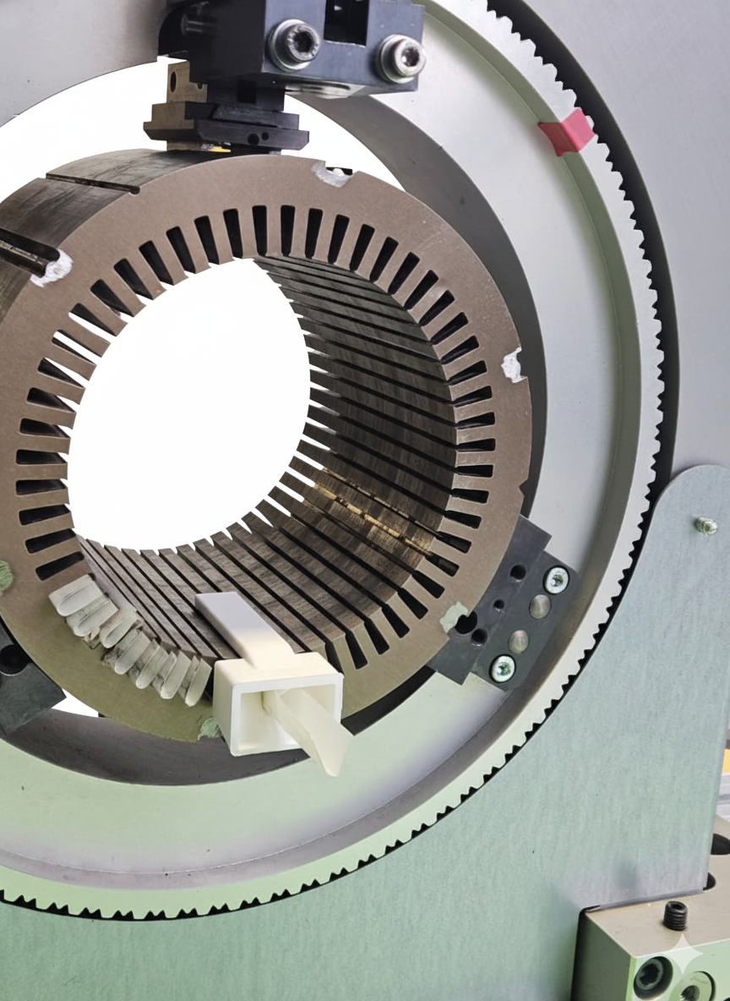
Discussion of Results: Insights and Areas for Further Improvement
Success rates & cycle time: Optimized trials achieved 96.7% for Stators A & B and 100% for Stator C; average cycle time ~39.8 s, with room for improvement via motion optimization.
Process sensitivity: Performance depends heavily on slot liner geometry and consistency; small deviations can cause errors.
Current limitations: The process does not yet incorporate automated folding, creasing, or shaping of liners.
Potential improvements: Automating liner pre-processing and integrating pre-positioned dispensers can reduce variability, minimize robot travel, and improve cycle time
Industrial relevance: Adding vision-based quality assurance and adaptive feedback could enable a fully autonomous, scalable, flexible, and robust solution for stator assembly

Slide 21
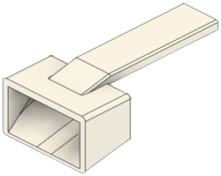
Discussion of Results: Insights and Areas for Further Improvement
Optimized trials achieved 96.7% for Stators A & B and 100% for Stator C.
Adding vision based systems and adaptive feedback can enable a fully autonomous system.
average cycle time ~39.8 s, with room for improvement via motion optimization..
The process does not yet incorporate automated folding, creasing, or shaping of liners
Performance depends heavily on slot liner geometry
Integrating Slot Liner dispenser with the rotating clamp can reduce robot travel and reduce cycle time

Slide 22
References
[1] IEA (2025), Global electric car sales, 2014-2024, IEA, Paris. https://www.iea.org/data-and-statistics/charts/global-electric-car-sales-2014-2024, Licence: CC BY 4.0
[2] Tiismus, Hans & Kallaste, Ants & Naseer, Muhammad & Vaimann, Toomas & Rassõlkin, Anton. (2022). Design and Performance of Laser Additively Manufactured Core Induction Motor. IEEE Access. 10. 1-16. 10.1109/ACCESS.2022.3173317.
[3} Nguyen, M. , Dario, S. , Malec, D. , Mary, D. , Cambronne, J. , Prunel, D. and Orgelet, J. (2017) Environmental Assessment and Dielectric Performances of the Secondary Electrical Insulation in Low Voltage Motors Impregnated by Different Techniques. Engineering, 9, 860-873. doi:10.4236/eng.2017.910051
[4] GMW Taiwan, GMW CS-2B Stator Slot Cell Inserter. [Online]. Available: https://​www.gmwtaiwan.com​/​Slot-​Cell-​Insertion-​Machine/​GMW-​CS-​2B-​Stator-​Slot-​Cell-​Inserter
[5] Universal Robots, UR10e. [Online]. Available: https://​www.universal-robots.com​/​products/​ur10e
[6] OnRobot, RG2 Gripper - Flexible 2 Finger Robot Gripper | OnRobot. [Online]. Available: https://​onrobot.com​/​us/​products/​rg2-​gripper OnRobot, Hex 6-Axis Force Torque Sensor | OnRobot. [Online]. Available: https://​onrobot.com​/​en/​products/​hex-​6-​axis-​force-​torque-​sensor (accessed: Aug. 20 2025).

Slide 24
Questions?

